Slide 1


Css gradient

Slide 2

Topics
Css gradient.
Css linear gradient.
Css radial gradient.

Slide 3
CSS Gradient
CSS gradients let you display smooth transitions between two or more specified colors

Slide 4
CSS Linear Gradient
It includes the smooth color transitions to going up, down, left, right, and diagonally. The minimum two-color required to create a linear gradient.
Syntax:
background-image: linear-gradient(direction, color-stop1, color-stop2,...);
Direction parameter : It can take values such as "to right", "to left", "to top", "to bottom", "to top left", "to top right", "to bottom left", or "to bottom right".
Color-stop parameters: specify the colors and positions of the gradient stops, You can specify as many color stops as you like, separated by commas.

Slide 5

Examples
Top to bottom:
CSS
Output
.box {
height: 50px;
background-image: linear-gradient(pink, purple);
// background-image: linear-gradient(to bottom, pink, purple);
}

Slide 6

Examples
Left to right:
CSS
Output
.box {
height: 50px;
background-image: linear-gradient(to right, pink, purple);
}

Slide 7
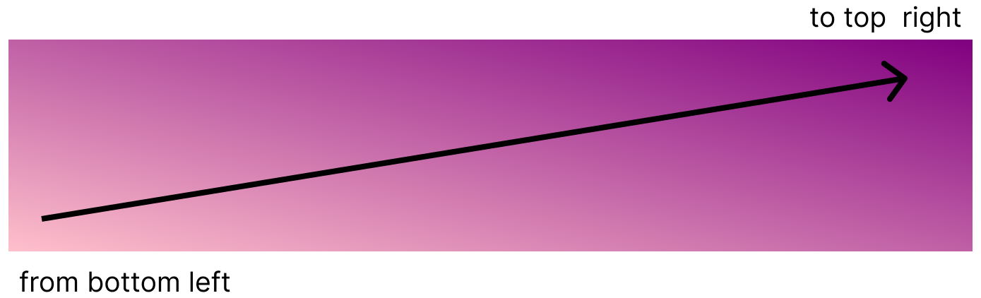
Examples
Diagonal : gradient that transitions smoothly between two or more colors diagonally instead of in a straight line. It can take the value such as “to top left", “to bottom left ”, “to bottom right”, “to top right”.
CSS
Output
.box {
height: 50px;
/* from bottom left to top right */
background-image: linear-gradient(to top right, pink, violet, purple);
}

Slide 8
CSS radial gradient
Radial gradient color transition start from the center.
background-image: radial-gradient(shape size at position, start-color, ..., last-color);
shape size parameter : Specifies the shape and side of the gradient, It can take values such as "circle", "ellipse", "closest-side", "closest-corner", "farthest-side", or farthest-corner.
You can also specify the size of the shape by using a length value or a percentage value.

Slide 9

Examples
CSS radial-gradient (evenly spaced color stops) : The fade happens at an equal rate, by default, its shape is an eclipse.
CSS
Output
.box {
height: 100px;
width: 100px;
background-image: radial-gradient(pink, purple);
}

Slide 10

Examples
CSS radial-gradient (differently spaced color stops): Can adjust the spacing between color stops in a CSS radial gradient by specifying position values for each color stop.
CSS
Output
.box {
height: 100px;
width: 100px;
background-image: radial-gradient(white 20px, yellow 30px, orange 40px);
/* background-image: radial-gradient(white 20%, yellow 30%, orange 40%); */
}

Slide 11
Set Shape
The shape parameter defines the shape. The default value is an ellipse. Here are the different values you can use for the "shape size" parameter:
“circle”
“ellipse”
“closest-side”
“closest-corner”
“farthest-side”
“farthest-corner”

Slide 12

Radial gradient examples with shape parameter
Circle: This value creates a circular shape for the gradient
CSS
Output
.box {
height: 100px;
width: 100px;
background-image: radial-gradient(circle, pink, violet, purple);
}

Slide 13
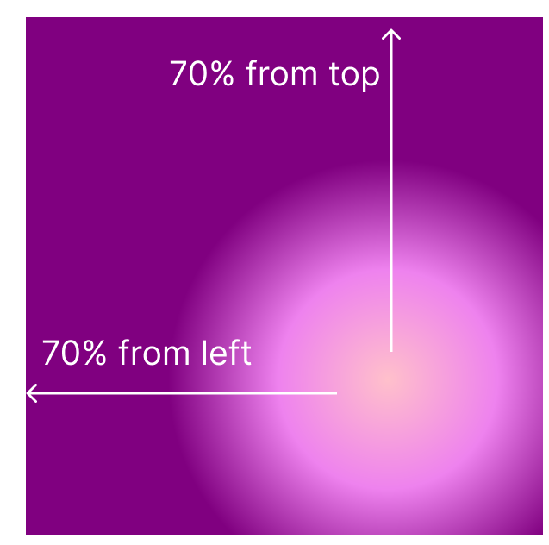
Radial gradient examples with shape parameter
closest-corner: This value creates a shape that is a circle or ellipse, depending on the aspect ratio of the element, with its size set to the smallest distance from the center of the gradient to the corners of the element.
CSS
Output
.box {
height: 100px;
width: 100px;
background-image: radial-gradient(closest-corner at 70% 55%, pink, violet, purple);
}

Slide 14

Radial gradient examples with shape parameter
Set the size of the shape by using a length or percentage value.
CSS
Output
.box {
height: 100px;
width: 100px;
background-image: radial-gradient(70% 30%, pink, purple);
/*
background-image: radial-gradient(70px 30px, pink, purple);
*/
}

Slide 15
THANK YOU

